Slide 1

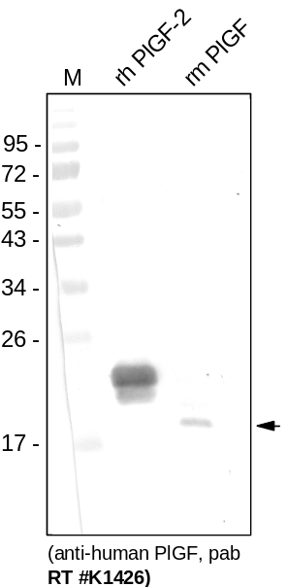
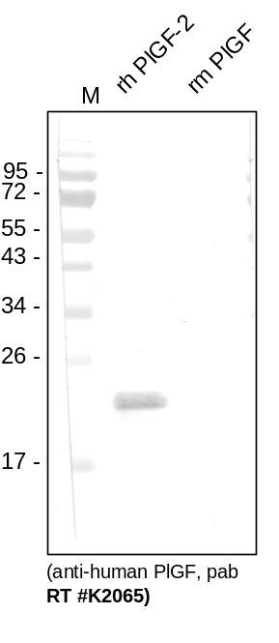
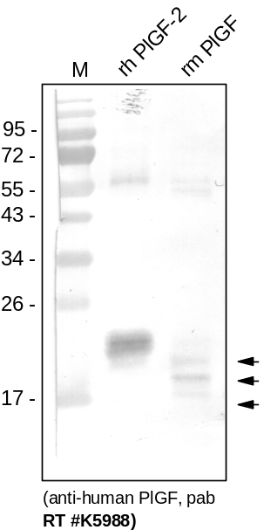
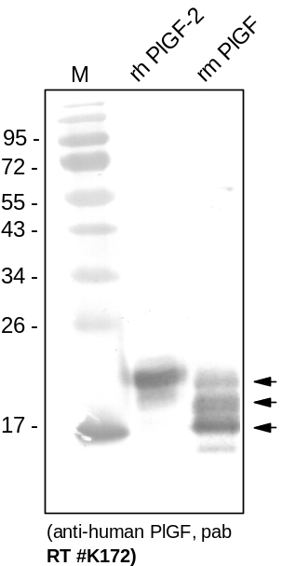
ReliaTech GmbH
Rabbit anti-human PlGF
(Cat# 102-PA04)
Western Analysis with different polyclonal antibodies against human PlGF. #K172 is directed against the first 20 amino acids of the native protein, for immunization of the other 3 antibodies recombinant human PlGF derived from insect cells was used. #K712 shows a strong cross reactivity with recombinant mouse PlGF (different glycosilated forms), #K5988 and #K1426 a weak one. #K2065 shows no cross reactivity with mouse PlGF.
http://www.reliatech.de / orders@reliatech.de

